Slide 1
So Far…
Our goal (supervised learning)
Learn a set of discriminant functions
Bayesian framework
We could design an optimal classifier if we knew:
P(ω_{i}) : priors and P(x | ω_{i}) : class-conditional densities
Using training data to estimate P(ω_{i}) and P(x | ω_{i})
Directly learning discriminant functions from the training data
Linear Regression
Logistic Regression
SVM
Kernel methods
Only focus on the classifier.
We have to know the form of the discriminant functions (the nonlinearity).
Disadvantage?
Notes:
In typical supervised pattern classification problems, the estimation
of the prior probabilities presents no serious difficulties (Problem 3). However, estimation
of the class-conditional densities is quite another matter. The number of
available samples always seems too small, and serious problems arise when the dimensionality
of the feature vector x is large.

Slide 2
Artificial Neural Network & Deep Learning
Deng Cai (蔡登)
College of Computer Science Zhejiang University
dengcai@gmail.com

Slide 3
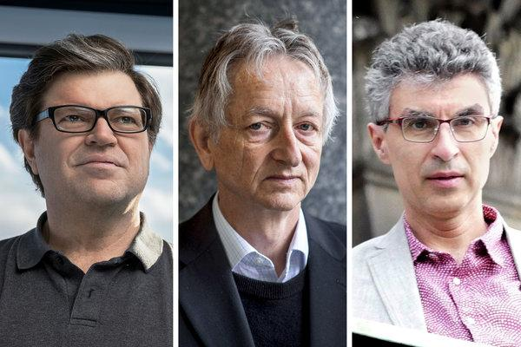
2019 Turing Award Winners
From left, Yann LeCun, Geoffrey Hinton and Yoshua Bengio. The researchers worked on key developments for neural networks, which are reshaping how computer systems are built.

Slide 4
What is Deep Learning
Deep learning is a branch of machine learning based on learning representations of data. It’s a set of algorithms that attempt to model high-level abstractions in data by using multiple processing layers, with complex structures or otherwise, composed of multiple non-linear transformations.
Research in this area attempts to make better representations and create models to learn these representations from large-scale unlabeled data.
Wiki

Slide 5

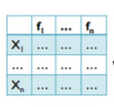
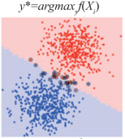



Supervised Learning
Learning from experience(training data), and build model to predict the future
Collect training samples
Define features
Design & Train
Model
Make prediction
Training phase
?
Test phase
Step 1
Step 2
Representation Learning

Slide 6
Supervised Learning
Define features
Design & Train
Model
Step 1
Step 2
Step 1 is more important in building a successful system.

Slide 7
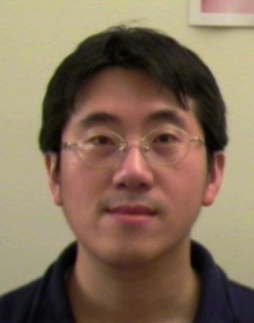
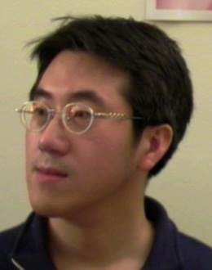
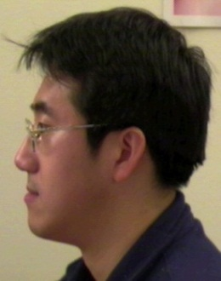
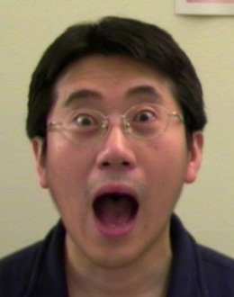
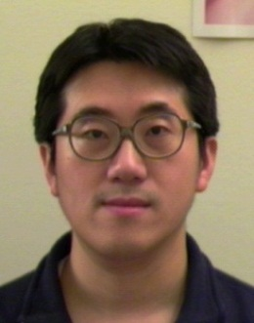
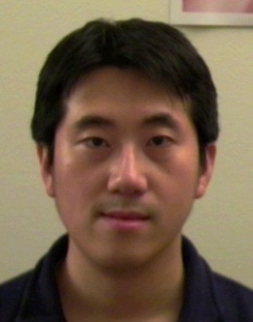
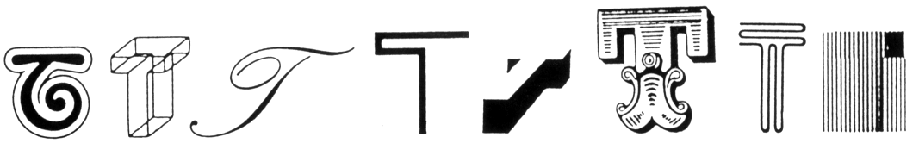
Why general classification hard?
Intra-class variability
Define features
The letter “T” in different typefaces
Step 1 is not
good enough
Same face under different expression, pose, illumination

Slide 8
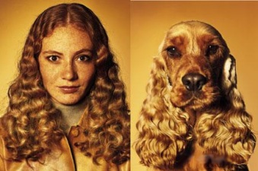
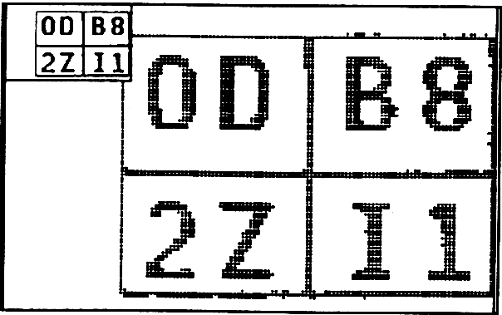
Why general classification hard?
Inter-class similarity
Define features
Step 1 is not
good enough

Slide 9
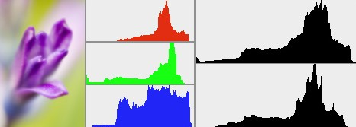
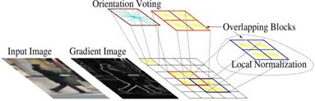
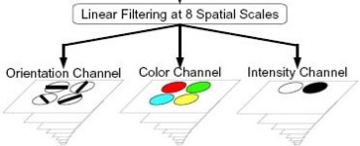
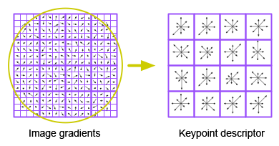
Representation (Feature)
1000
colorHistogram,1992
600
HOG (Histogram of Oriented Gradients),2005
GIST,2001, 2003
SIFT,1999, 2004
Notes:
GIST summarizes the gradient information (scales and orientations) for different parts of an image

Slide 10
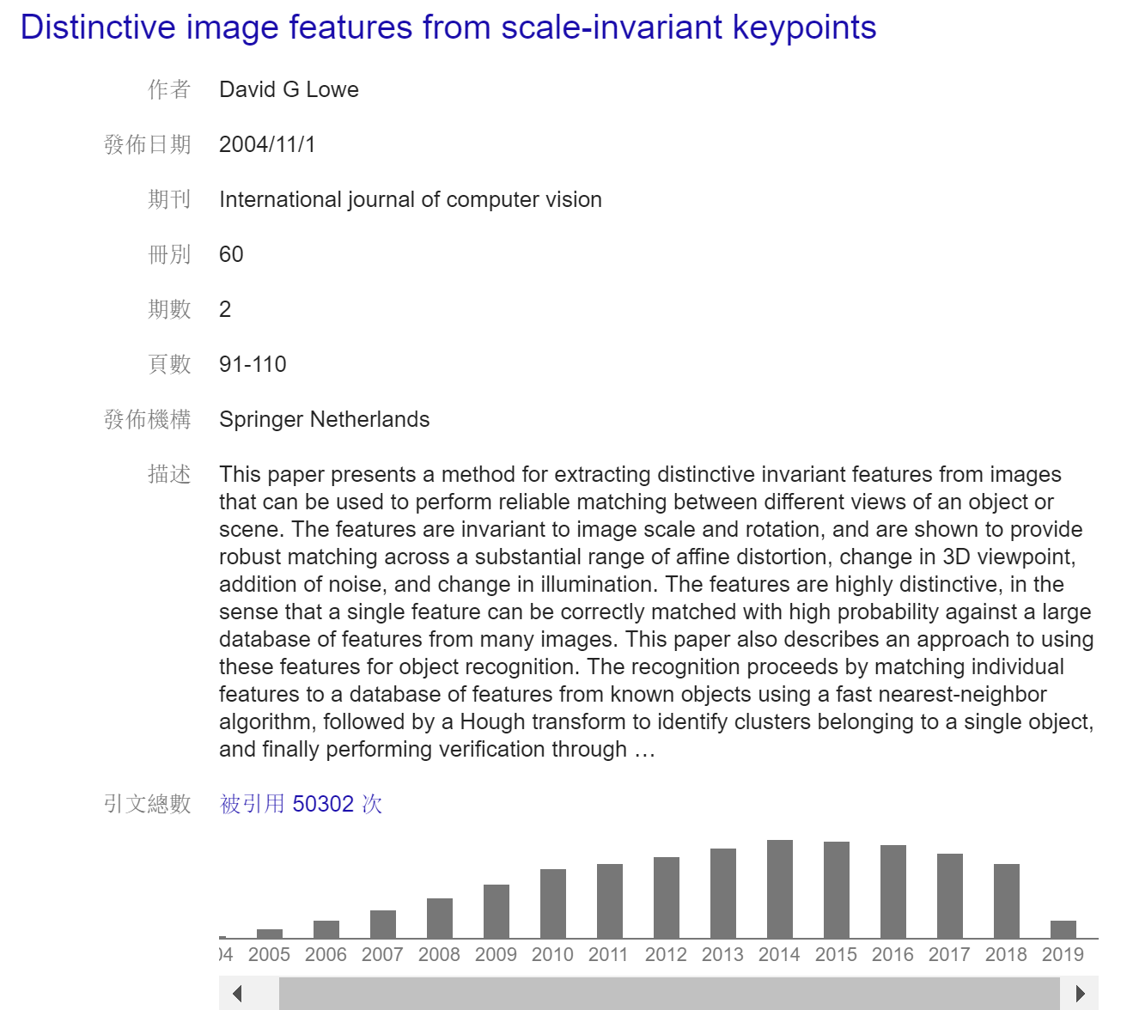
SIFT

Slide 11
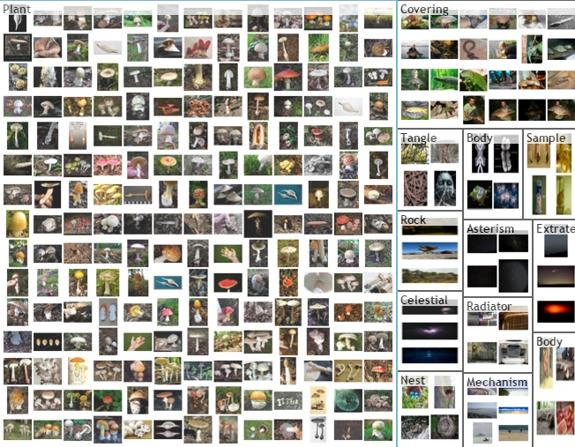
Imagenet competition Large Scale Visual Recognition Challenge (ILSVRC)
2010 ~ 2017
1000 categories, from flickr and other search engines
1.2 million training images
50,000 validation images , 100,000 test images

Slide 12
ImageNet Classification top-5 error(%)

Slide 13
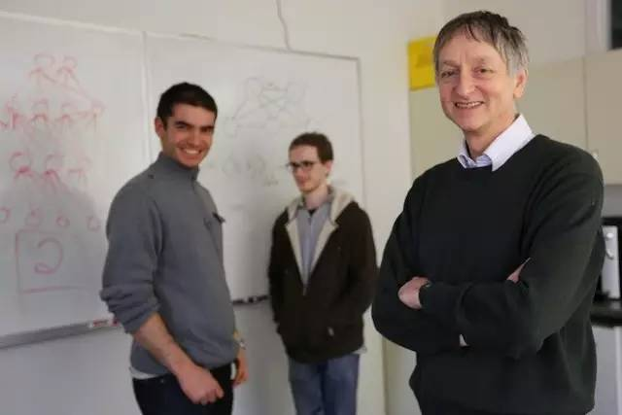
Imagenet break through
Suskever, Krizhevsky, Hinton, from left to right

Slide 14
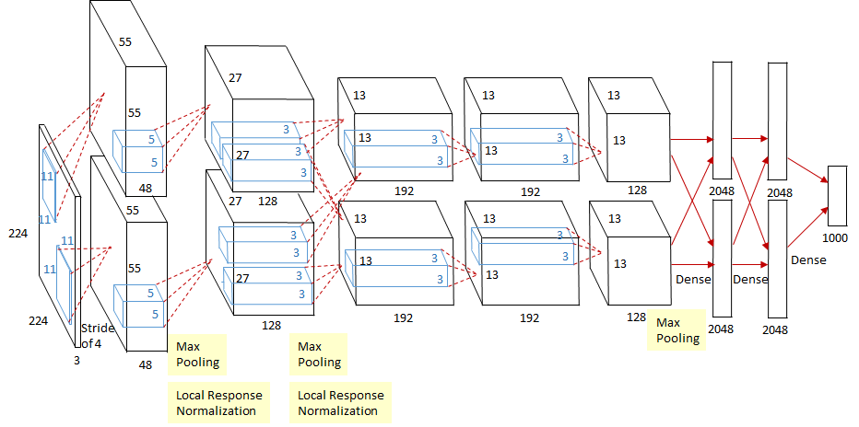
AlexNet (Alex Krizhevsky)

Slide 15
ImageNet Classification top-5 error(%)

Slide 16
Deep Learning
(Neural Network, NN)
(Artificial Neural Network, ANN)
Notes:
从 Perceptron，

Slide 17
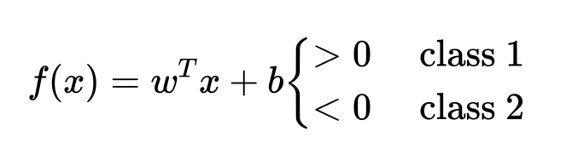
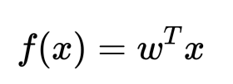
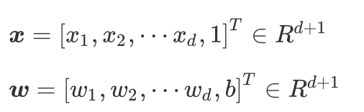
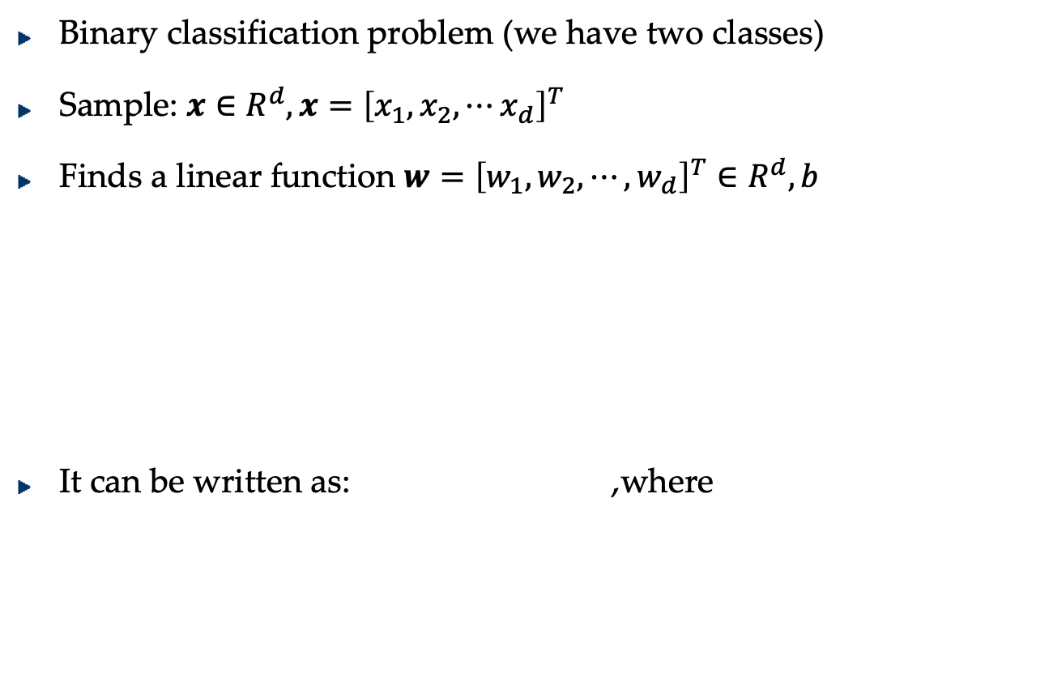
Linear model (classifier)
Binary classification problem (we have two classes)
Sample: $x∈R^{d},x={\left[x_{1},x_{2},⋯x_{d}\right]}^{T}$
Finds a linear function $w={\left[w_{1},w_{2},⋯,w_{d}\right]}^{T}∈R^{d},b$
It can be written as: ,where

Slide 18
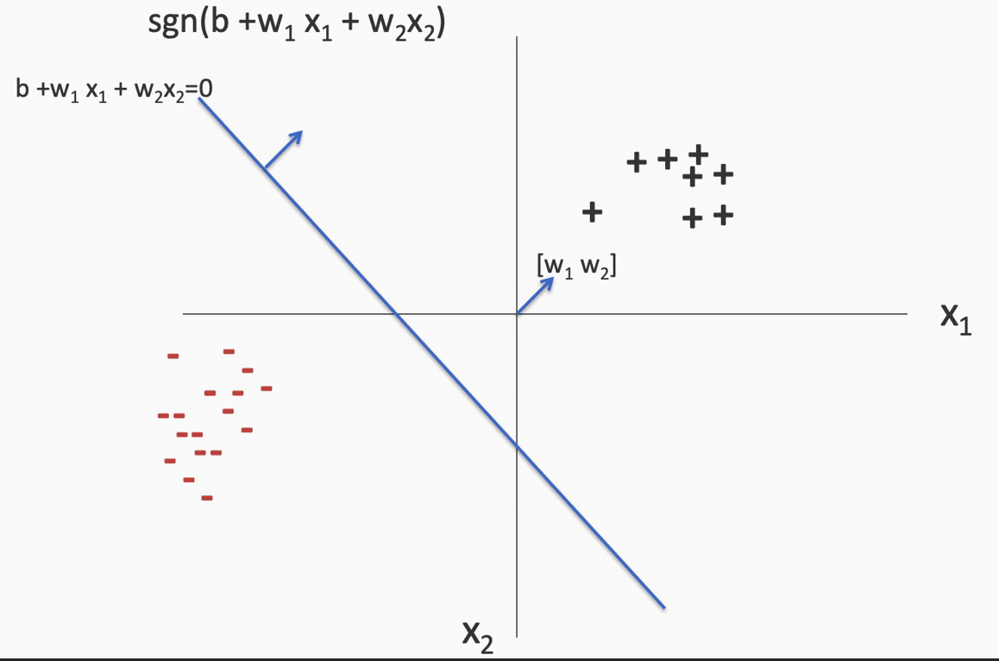
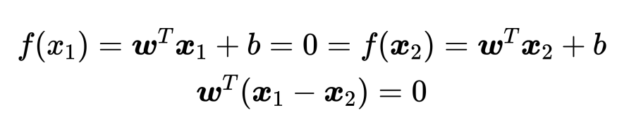
Linear model (classifier)
The geometry of a linear classifier
Q1. What is the normal vector of this hyper-plane?
In n dimensions, a linear classifier represents a hyperplane that separates the space into half-spaces

Slide 19
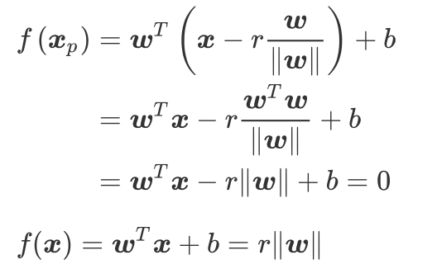
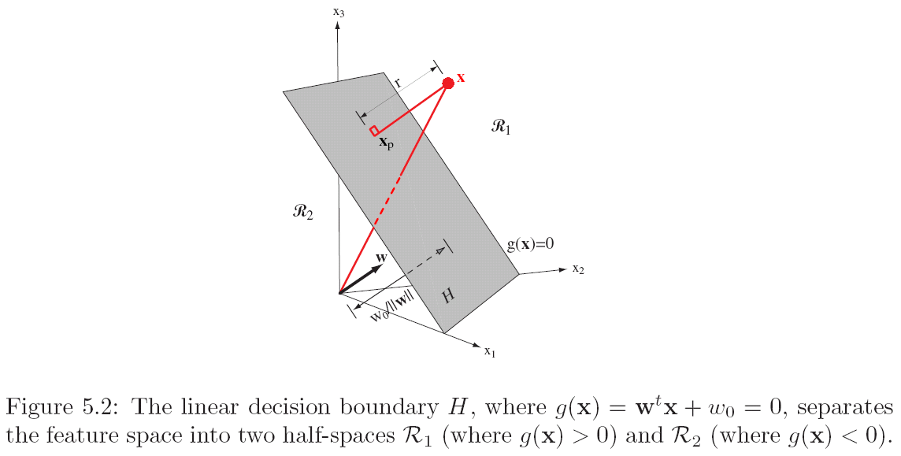
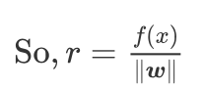
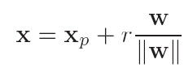
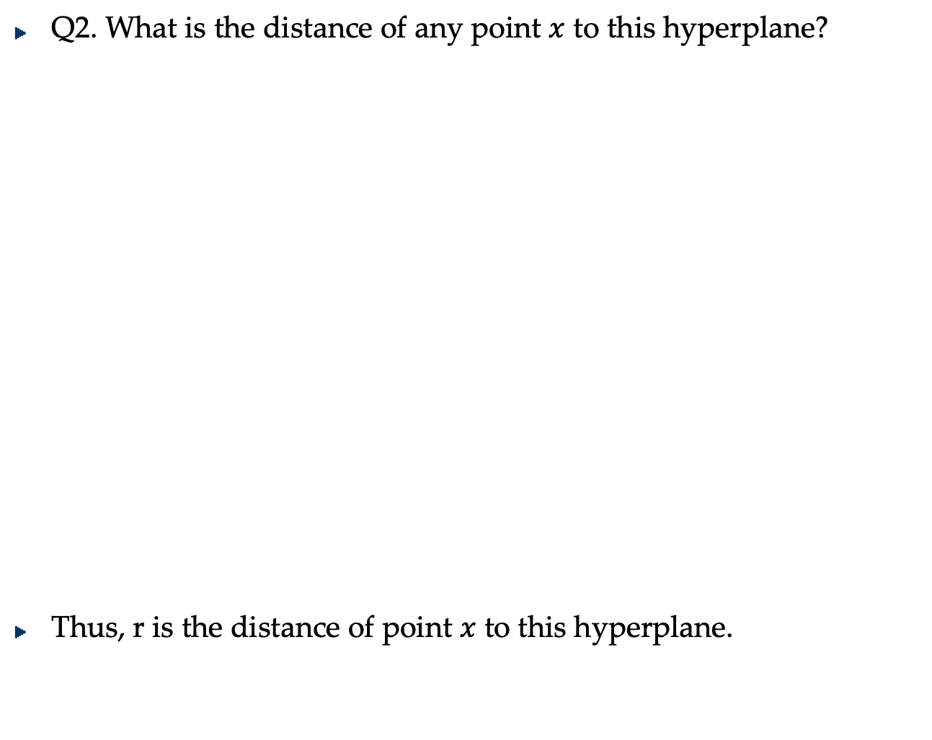
Linear model (classifier)
Q2. What is the distance of any point $x$ to this hyperplane?
Thus, r is the distance of point $x$ to this hyperplane.

Slide 20
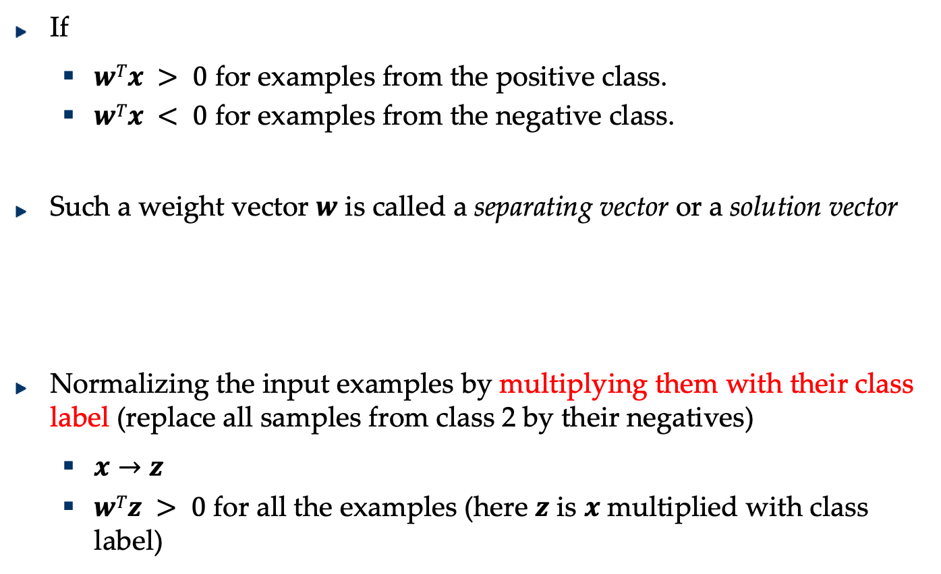
Two-category Linearly Separable Case
If
$wTx > 0$ for examples from the positive class.
$wTx < 0$ for examples from the negative class.
Such a weight vector $w$ is called a separating vector or a solution vector
Normalizing the input examples by multiplying them with their class label (replace all samples from class 2 by their negatives)
$x→z$
$wTz > 0$ for all the examples (here $z$ is $x$ multiplied with class label)

Slide 21
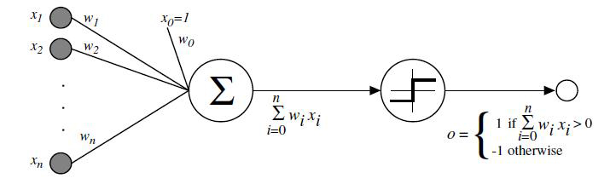

Perceptron
Binary classification problem (we have two classes)
Sample: $x∈R^{d},x={\left[x_{1},x_{2},⋯x_{d}\right]}^{T}$
Finds a linear function $w={\left[w_{1},w_{2},⋯,w_{d}\right]}^{T}∈R^{d},b$
Input weight Sum threshold output

Slide 22
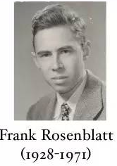
Perceptron
In 1957, Frank Rosenblatt in Cornell University invented the Perceptron model. It is:
The first self-organizing and self-learning mathematic model.
The first algorithm defining Neural Network precisely.
The ancestor of many new Neural Network models.

Slide 23
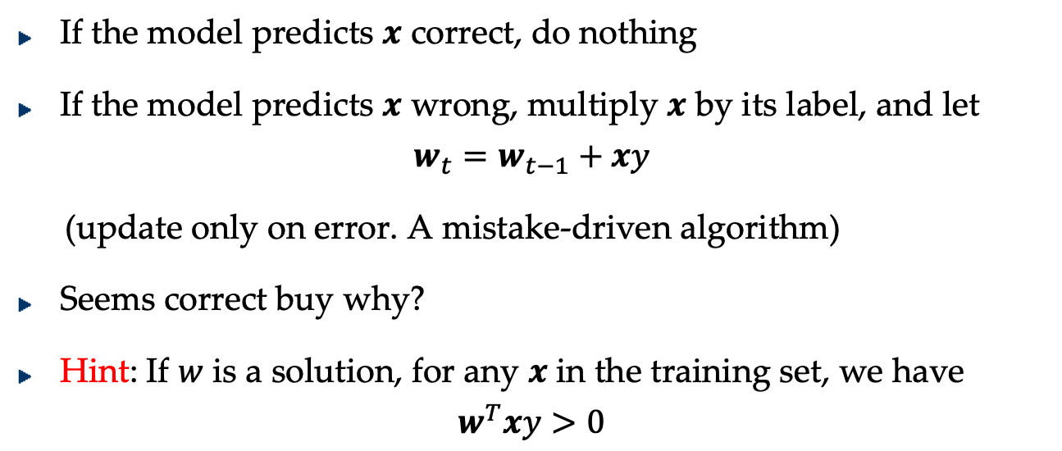
The Perceptron learning algorithm
How to Learn?
If the model predicts $x$ correct, do nothing
If the model predicts $x$ wrong, multiply $x$ by its label, and let
$$w_{t}=w_{t−1}+xy$$
(update only on error. A mistake-driven algorithm)
Seems correct buy why?
Hint: If $w$ is a solution, for any $x$ in the training set, we have
$$w^{T}xy>0$$

Slide 24
Neural Network (Deep Learning) History & Progress
1957, Perceptron created by Frank Rosenblatt (60 years ago)
This model had been quite popular in the 1960s.
Rosenblatt had a hopeful view of percetron, predicting that it would be able to learn, to make decisions, and to translate.
The US Navy used to fund its research, expecting that it “will be able to walk, talk, see, write, reproduce itself and be conscious of its existence”, till the first AI winter came.

Slide 25
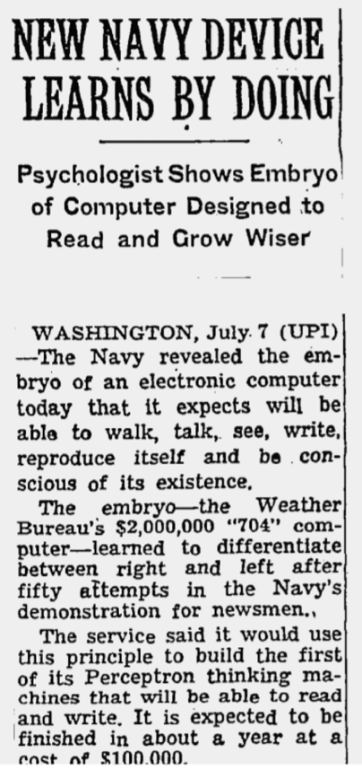
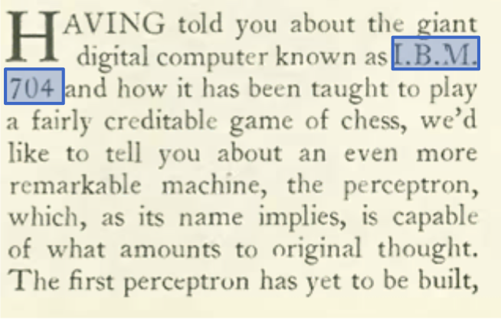
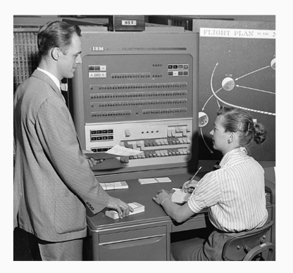
Neural Network (Deep Learning) the hype
The New Yorker, December 6, 1958 P.44
The New York Times, July 8 1958
The IBM 704 computer

Slide 26

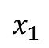
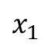
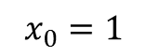
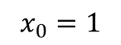


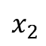
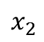
Perceptron: Drawback
Only capable of learning linearly separable functions.
Logical OR gate
Logical AND gate
x1 | x2 | out
0 | 0 | 0
0 | 1 | 1
1 | 0 | 1
1 | 1 | 1
$$x_{0}=1$$
$$x_{1}$$
1
0.5
$$Σ$$
$$x_{2}$$
1
x1 | x2 | out
0 | 0 | 0
0 | 1 | 0
1 | 0 | 0
1 | 1 | 1
$$x_{0}=1$$
$$x_{1}$$
-1.5
1
$$Σ$$
1
$$x_{2}$$

Slide 27
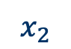
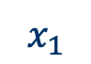


Perceptron: Drawback
Only capable of learning linearly separable functions.
Logical XOR gate
$$x_{0}=1$$
x1 | x2 | out
0 | 0 | 0
0 | 1 | 1
1 | 0 | 1
1 | 1 | 0
$$x_{1}$$
0.5
w1=?
$$Σ$$
$$x_{2}$$
w2=?
What is the threshold?

Slide 28
The First Winter
In 1969, Marvin Minsky and Seymour Paper published the monograph “Perceptrons: an introduction to computational geometry ”.
This book revealed two fatal shortcomings of the perceptron model:
Single layered perceptron is not able to solve problems with non-linearity , e.g. XOR gate.
Its computation budget was too huge for the computers at that age.
In the next more than ten years, the NN-based AI researches were nearly abandoned and related projects could not get any funds from the government.
This period has been called the first AI Winter.
Rosenblatt died in 1971 in an accident, not lucky enough to witness the renaissance of NN research.

Slide 29
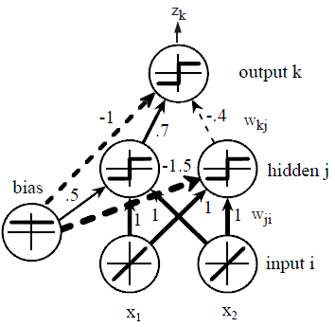

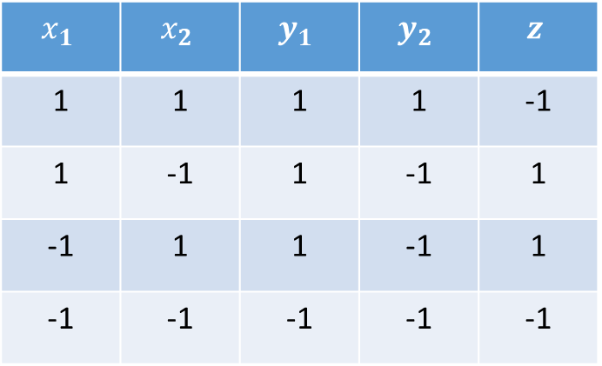
Neural Network (Deep Learning) History & Progress
1957, Perceptron created by Frank Rosenblatt (60 years ago)
1969, the first AI winter caused by “Perceptrons”
$$x_{1}$$ | $$x_{2}$$ | $$y_{1}$$ | $$y_{2}$$ | $$z$$
1 | 1 | 1 | 1 | -1
1 | -1 | 1 | -1 | 1
-1 | 1 | 1 | -1 | 1
-1 | -1 | -1 | -1 | -1
$$z = x1 XOR x2$$
What is the relation between z and x_{i}?
Assume x₁ and x₂ are -1, +1

Slide 30
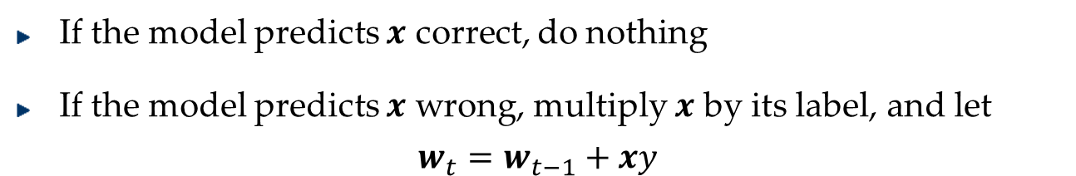
Perceptron vs. Multi-layer Perceptron
If the model predicts $x$ correct, do nothing
If the model predicts $x$ wrong, multiply $x$ by its label, and let
$$w_{t}=w_{t−1}+xy$$
How to Learn?

Slide 31
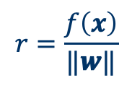

Principle Way To Learn Perceptron
Define the Criterion Function (Loss Function) of Perceptron
Then optimize(minimize) this function
What is the criterion function of perceptron?
If an example can be correctly predicted, No penalty.
If the model made an error on an example, how to put the penalty?
$$J\left(w\right)=−\sum_{i∈I_{M}}{{w^{T}x_{i}y}_{i}}$$
$$r=\frac{f\left(x\right)}{\text{‖}\text{w}\text{‖}}$$
Hint:
The criterion is proportional to the sum of distances from the misclassified samples to the decision boundary.

Slide 32


Gradient Descent

Slide 33





Optimization Algorithm
$$J\left(w\right)=−\sum_{i∈I_{M}}{{w^{T}x_{i}y}_{i}}$$
Use gradient descent to find $w$
Move in the negative direction of the gradient iteratively to reach the minima.
The gradient vector is given by,
Starting from $w=0$, update $w$ at each iteration k as follows:
If the model predicts $x$ correct, do nothing
If the model predicts $x$ wrong, multiply $x$ by its label, and let
$$w_{t}=w_{t−1}+xy$$
$$∇J=\sum_{i∈I_{M}}{−{x_{i}y}_{i}}$$
$$w\left(k+1\right)=w\left(k\right)+η\left(k\right)\sum_{i∈I_{M}^{k}}{{x_{i}y}_{i}}$$

Slide 34
Batch learning vs. Online learning
Batch learning
All the training samples are available
Online learning or mini-batch learning
The learning algorithm sees the training samples one by one.
What is the advantages of online (mini-batch) learning?
Training speed
Iteration number VS. Training Time
Memory cost
Convergence of online training?

Slide 35

Optinal: Mistake Bound Theorem
The margin of a hyperplane for a dataset is the distance between the hyperplane and the data point nearest to it.
Margin with respect to this hyperplane

Slide 36

Optinal: Mistake Bound Theorem
Maintains a weight vector $w∈ℛ^{p}$, $w_{1}=\left(0,⋯,0\right)$.
Upon receiving an example $x∈ℛ^{p}$
Predicts according to the linear threshold function $\text{sgn}\left(w^{T}x\right)$.
Theorem [Novikoff,1963] Let $\left(x_{1},y_{1}\right)⋯\left(x_{t},y_{t}\right)$, be a sequence of labeled examples with $x_{i}∈ℛ^{p}$, $\left\|x_{i}\right\|≤R$ and y_{i} ∈{-1,1} for all i. Let $u∈ℛ^{p}$, γ > 0 be such that $y_{i}u^{T}x_{i}≥γ$ for all i. Then Perceptron makes at most $\frac{{\left\|u\right\|}^{2}R^{2}}{γ^{2}}$ mistakes on this example sequence.
$$\frac{\max_{i}{{\left\|x_{i}\right\|}^{2}}{\left\|u\right\|}^{2}}{\min_{i}{{\left(y_{i}u^{T}x_{i}\right)}^{2}}}$$
Margin Complexity Parameter

Slide 37








Perceptron-Mistake Bound
Proof: Let $u$ be any solution vector, so that $y_{i}u^{T}x_{i}$ is strictly positive for all $i$, and let $α$ be a positive scale factor.
$$w_{k+1}−αu=\left(w_{k}−αu\right)+y_{k}x_{k}$$
$${\left\|w_{k+1}−αu\right\|}^{2}={\left\|w_{k}−αu\right\|}^{2}+2{\left(w_{k}−αu\right)}^{T}y_{k}x_{k}+{\left\|x_{k}\right\|}^{2}$$
$${\left\|w_{k+1}−αu\right\|}^{2}≤{\left\|w_{k}−αu\right\|}^{2}−2αu^{T}y_{k}x_{k}+{\left\|x_{k}\right\|}^{2}$$
$${\left\|w_{k+1}−αu\right\|}^{2}≤{\left\|w_{k}−αu\right\|}^{2}−2αγ+R^{2}$$
Assumptions
$$y_{i}u^{T}x_{i}≥γ$$
$$\left\|x_{i}\right\|≤R$$
$$w_{1}=\left(0,⋯,0\right)$$
$$\text{Let} α=\frac{R^{2}}{γ}$$
$${\left\|w_{k+1}−αu\right\|}^{2}≤{\left\|w_{k}−αu\right\|}^{2}−R^{2}$$
$${\left\|w_{k}−αu\right\|}^{2}≤{\left\|w_{k−1}−αu\right\|}^{2}−R^{2}$$
$$⋮$$
$${\left\|w_{2}−αu\right\|}^{2}≤{\left\|w_{1}−αu\right\|}^{2}−R^{2}$$
$$0≤$$
$${\left\|w_{k+1}−αu\right\|}^{2}≤{\left\|w_{1}−αu\right\|}^{2}−kR^{2}$$
$$k_{max}=\frac{{\left\|w_{1}−αu\right\|}^{2}}{R^{2}}$$
$$k_{max}=\frac{{α^{2}\left\|u\right\|}^{2}}{R^{2}}=\frac{{\left\|u\right\|}^{2}R^{2}}{γ^{2}}$$

Slide 38

Perceptron vs. Multi-layer Perceptron
$$w\left(k+1\right)=w\left(k\right)+η\left(k\right)\sum_{i∈I_{M}^{k}}{{x_{i}y}_{i}}$$
Gradient descent
How to Learn?
Backpropagation

Slide 39
Neural Network (Deep Learning) History & Progress
1957, Perceptron created by Frank Rosenblatt (60 years ago)
1969, the first AI winter caused by “Perceptrons”
1970s, Backpropagation was introduced and wasn’t valued
Paul J. Werbos (born 1947)
Paul Werbos (1974). Beyond regression: New tools for prediction and analysis in the behavioral sciences. PhD thesis, Harvard University.
“Mentioned the possibility of applying this principle to artificial neural network”
1986, Backpropagation was reinvented
Rumelhart, David E.; Hinton, Geoffrey E.; Williams, Ronald J. (8 October 1986). "Learning representations by back-propagating errors". Nature. 323 (6088): 533–536.
“Showed through computer experiments that this method can generate useful internal representations of incoming data in hidden layers of neural networks”

Slide 40


BP & Geoffrey Hinton
In 1970, when the first AI winter came, Geoffrey Hinton, a 23-years-old young man, gained his bachelor’s degree of experimental psychology from Cambridge.
And then, he chose to get a PhD at the University of Edinburgh, on AI, nearly if not exactly equal to NN at that time.
His friends were confused about his decision and thought he must be crazy, because NN had been proved to be sheer nonsense, by the book “Perceptrons”.

Slide 41













Backpropagation Algorithm
$$J$$
$$w_{ji}$$
$$w_{kj}$$
$$z_{k}$$
$$x_{i}$$
$${net}_{k}$$
$${net}_{j}$$
$$y_{j}$$
$$i$$
$$j$$
$$k$$
$$∆w=−η∇J=−η\frac{∂J}{∂w}$$
Where $η$ is the learning rate which indicates the relative size of the change in weights
$$w^{\left(t+1\right)}=w^{\left(t\right)}+∆w^{\left(t\right)}$$
where t indexes the particular pattern presentation

Slide 42
















Backpropagation Algorithm
$$J=\frac{1}{2}\sum_{k=1}^{c}{{\left(t_{k}−z_{k}\right)}^{2}}$$
$$w_{ji}$$
$$w_{kj}$$
$$z_{k}$$
$$x_{i}$$
$${net}_{k}$$
$${net}_{j}$$
$$y_{j}$$
$$net_{j}=\sum_{j=0}^{d}{x_{i}w_{ji}}$$
$$net_{k}=\sum_{j=0}^{n_{H}}{y_{j}w_{kj}}$$
$$\frac{∂J}{∂w_{kj}}$$
$$=\frac{∂J}{∂z_{k}}∙\frac{∂z_{k}}{∂{net}_{k}}∙\frac{∂{net}_{k}}{∂w_{kj}}$$
$$=\left(z_{k}−t_{k}\right)∙f^{′}\left(net_{k}\right)∙y_{j}$$
$$\frac{∂J}{∂w_{ji}}$$
$$=\frac{∂J}{∂y_{j}}∙\frac{∂y_{j}}{∂{net}_{j}}\frac{∂{net}_{j}}{∂w_{ji}}$$
$$=\left(\sum_{k=1}^{c}{\left(z_{k}−t_{k}\right)∙f^{′}\left(net_{k}\right)∙w_{kj}}\right)∙f^{′}\left(net_{j}\right)∙x_{i}$$

Slide 43

Natural Neural Net Models
Human brain consists of very large number of neurons (between ${10}^{10}$ to ${10}^{12}$)
No. of interconnections per neuron is between 1K to 10K
Total number of interconnections is about ${10}^{14}$
Damage to a few neurons or synapse (links) does not appear to impair overall performance significantly (robustness)

Slide 44


The Artificial Neural Network
A cartoon drawing of a biological neuron
Notes:
nucleus:细胞核
dendrites: 树突
Axon 轴突
Axon terminals 轴突末端

Slide 45
The Artificial Neural Network (Deep Learning)

Slide 46


Linear (simple) decision boundary VS. Complex decision boundary
Which one is better?

Slide 47

Bias-variance Decomposition
$EPE\left(f\right)=\iint{{(y−f\left(x\right))}^{2}p\left(x,y\right)dxdy}$
Expected prediction error (expected loss) =
(bias)² + variance + noise
(bias)²:
$$\int{{\left\{E_{D}\left(f\left(x;D\right)\right) −E\left(y|x\right)\right\}}^{2}p\left(x\right)dx}$$
variance:
$$\int{E_{D}\left\{{\left[f\left(x;D\right)−E_{D}\left(f\left(x;D\right)\right)\right]}^{2}\right\}p\left(x\right)dx}$$
noise:
$$\int{\text{var}\left(y|x\right)p\left(x\right)dx}$$

Slide 48

General Feedforward Operation
Case of c output units
$$g_{k}\left(x\right)≡z_{k}=f\left(\sum_{j=1}^{n_{H}}{w_{kj}}f\left(\sum_{i=1}^{d}{w_{ji}x_{i}}+w_{j0}\right)+w_{k0}\right)$$
$$k=1,⋯,c$$
Hidden units enable us to express more complicated nonlinear functions and extend classification capability
Assume for now that all activation functions are identical
Question: Can every decision boundary be implemented by a three-layer network described by the above equation?

Slide 49

Expressive Power of Multi-layer Networks
Answer: Yes (due to A. Kolmogorov)
Any continuous function from input to output can be implemented in a three-layer net, given sufficient number of hidden units $n_{H}$, proper nonlinearities, and weights.
Any continuous function $g\left(x\right)$ defined on the unit hypercube $I^{n}\left(I=\left[0,1\right] \text{and} n≥2\right)$ can be represented in the following form:
$$g\left(x\right)=\sum_{j=1}^{2n+1}{Ξ_{j}\left(\sum_{i=1}^{d}{Φ_{ij}\left(x_{i}\right)}\right)}$$
for properly chosen functions $Ξ_{j}$ and $Φ_{ij}$

Slide 50


Slide 51
Artificial Neural Net Models
Artificial Neural nets are specified by
Net topology
Node (processor) characteristics
Training/learning rules

Slide 52
Artificial Neural Net Models
Artificial Neural nets are specified by
Net topology
Node (processor) characteristics
Training/learning rules
Backpropagation

Slide 53
Neural Network (Deep Learning) History & Progress
1957, Perceptron created by Frank Rosenblatt (60 years ago)
1969, the first AI winter caused by “Perceptrons”
1970s, Backpropagation was introduced and wasn’t valued
1986, Backpropagation was reinvented
1989, Convolutional Neural Network (CNN) by Yann LeCun
1980s, Recurrent Neural Network was created
1997, Long Short Term Memory networks(LSTM) by Hochreiter & Schmidhuber

Slide 54

Yann Lecun
Yann Lecun
Burn in Paris in 1960.
In 1987, after receiving PhD in France, he worked as a postdoctoral researcher with Hinton for one year, and then in Bell Labs.

Slide 55
BP & CNN
In 1989, Yann Lecun published the paper “Backprop-agation applied to handwritten zip code recognition“.
In the paper, he trained a CNN model with about 10,000 hand-written-digit images provided by the US Postal System and achieved an test error rate of 5%.
A CNN-based commercial software was also developed by Lecun to recognize the hand-written digits on checks. It had occupied about 20% of the market share in the late 1990s US.

Slide 56
Neural Network (Deep Learning) History & Progress
1957, Perceptron created by Frank Rosenblatt (60 years ago)
1969, the first AI winter caused by “Perceptrons”
1970s, Backpropagation was introduced and wasn’t valued
1986, Backpropagation was reinvented
1989, Convolutional Neural Network (CNN) by Yann LeCun
1980s, Recurrent Neural Network was created
1997, Long Short Term Memory networks(LSTM) by Hochreiter & Schmidhuber
For about 20 years, the second winter brought by SVM

Slide 57

The second winter
However, at the time when CNN was ready to enjoy its booming, a researcher in Bell Labs, whose office was quite near to Yann Lecun’s, brought the second winter to NN research.
Vladmir Vapnik
Burn in the former Soviet Union in 1936
Migrated to US in 1990 and worked in Bell Labs.
Early in 1963, Vapnik invented the Support Vector Machine (SVM) algorithm.

Slide 58
The second winter
The SVM, as an exquisite classification algorithm, started to find its prosperity in image and voice recognition, in the early 1990s.
In Bell Labs on the corridor, Yann Lecun and Vapnik often had fever discussions on the strength and weakness of NN and SVM.
On the recognition task of hand-written digits, the SVM had kept making progress:
By 1998, the error rate had been reduced to 0.8% .
By 2002, 0.56%
It had obviously exceeded the contemporary performances of NN.

Slide 59

The second winter
Geoff Hinton sits at the head of the table at the 2003 Vancouver workshop, where he and his fellow academics convinced the Canadian Institute for Advanced Research (CIFAR) to agree to fund their work.

Slide 60
The second winter
In 2004, Canadian Institute for Advanced Research (CIFAR) agreed to support the NN research by giving about $10 million over 10 years.
By then, CIFAR was the only organization funding the research of NN.
Without the support of CIFAR, the AI research of human beings may have to stagger in darkness for many more years.

Slide 62
Something about ‘deep’ and ‘learning’
For neural networks, being deeper means being more powerful and expressive.
So, why not going deeper at the very beginning?
The vanishing gradient problem.
Expensive computation budget.
The advances in handling these problems witnessed by the last decade are the prerequisites for the popularization of deep neural networks, i.e., deep learning.

Slide 63
Artificial Neural Net Models
Artificial Neural nets are specified by
Net topology
Node (processor) characteristics
Training/learning rules

Slide 64

Activation Function
Activation Function $f$
Must be non-linear (otherwise, 3-layer network is just a linear discriminant) and saturate (have max and min value) to keep weights and activation functions bounded
Activation function and its derivative must be continuous and smooth; optionally monotonic
Choice may depend on the problem. Eg. Gaussian activation if the data comes from a mixture of Gaussians
Eg: sigmoid (most popular), polynomial, tanh
Parameters of activation function (e.g. Sigmoid)
Centered at 0, odd function f(-net) = -f(net) (anti-symmetric); leads to faster learning
Depend on the range of the input values

Slide 65



Activation Function
Additional tip: Also good to normalize inputs to mean zero and use random weight initialization with avg. weight centered at zero
Advantages of Tanh • Mean centering • Positive and negative values
• Larger gradients
Notes:
$$σ\left(S\right)=\frac{1}{1+e^{−S}}$$
Advantages:
Looks very similar to the step function
Is differentiable
Derivative can be easily expressed in term of itself $$\frac{dσ\left(S\right)}{dS}=σ\left(S\right)\left(1−σ\left(S\right)\right)$$

Slide 66




Activation Function
Alpha is a trainable parameter.
Notes:
$$σ\left(S\right)=\frac{1}{1+e^{−S}}$$
Advantages:
Looks very similar to the step function
Is differentiable
Derivative can be easily expressed in term of itself $$\frac{dσ\left(S\right)}{dS}=σ\left(S\right)\left(1−σ\left(S\right)\right)$$

Slide 67


Activation Function
The anti-symmetric sigmoid function: f(-x) = -f(x).
a = 1.716, b = 2/3.
First order derivative
Notes:
$$σ\left(S\right)=\frac{1}{1+e^{−S}}$$
Advantages:
Looks very similar to the step function
Is differentiable
Derivative can be easily expressed in term of itself $$\frac{dσ\left(S\right)}{dS}=σ\left(S\right)\left(1−σ\left(S\right)\right)$$

Slide 68













Backpropagation Algorithm
$$w_{ji}$$
$$w_{kj}$$
$$z_{k}$$
$$x_{i}$$
$${net}_{k}$$
$${net}_{j}$$
$$y_{j}$$
$$\frac{∂J}{∂w_{kj}}$$
$$=\frac{∂J}{∂z_{k}}∙\frac{∂z_{k}}{∂{net}_{k}}∙\frac{∂{net}_{k}}{∂w_{kj}}$$
$$=\left(z_{k}−t_{k}\right)∙f^{′}\left(net_{k}\right)∙y_{j}$$
$$\frac{∂J}{∂w_{ji}}$$
$$=\frac{∂J}{∂y_{j}}∙\frac{∂y_{j}}{∂{net}_{j}}\frac{∂{net}_{j}}{∂w_{ji}}$$
$$=\left(\sum_{k=1}^{c}{\left(z_{k}−t_{k}\right)∙f^{′}\left(net_{k}\right)∙w_{kj}}\right)∙f^{′}\left(net_{j}\right)∙x_{i}$$

Slide 69
















Backpropagation Algorithm
$$w_{1}$$
$$w_{2}$$
$$w_{3}$$
$$w_{4}$$
$$x_{1}$$
$$x_{2}$$
$$x_{3}$$
$$x_{4}$$
$$z$$
$$\frac{∂J}{∂w_{4}}=\frac{∂J}{∂z}∙f^{′}\left(net_{4}\right)∙x_{4}$$
vanishing gradient problem
$$\frac{∂J}{∂w_{3}}=\frac{∂J}{∂z}∙f^{′}\left(net_{4}\right)∙w_{4}∙f^{′}\left(net_{3}\right)∙x_{3}$$
$$\frac{∂J}{∂w_{2}}=\frac{∂J}{∂z}∙f^{′}\left(net_{4}\right)∙w_{4}∙f^{′}\left(net_{3}\right)∙w_{3}f^{′}\left(net_{2}\right)∙x_{2}$$
First order derivative
$$<1$$
$$<1$$
$$<1$$
$$<1$$
$$\frac{∂J}{∂w_{1}}=\frac{∂J}{∂z}∙f^{′}\left(net_{4}\right)∙w_{4}∙f^{′}\left(net_{3}\right)∙w_{3}f^{′}\left(net_{2}\right)∙w_{2}f^{′}\left(net_{1}\right)∙x_{1}$$

Slide 70

2011, ReLU RevoLUtion
In 2011, Canadian scholar Xavier Glorot and Yoshua Bengio published the paper “Deep Sparse Rectifier Neural Networks “.
The paper proposed a new activation function, Rectified Linear Unit (ReLU):
ReLU(x) = max (0, x )

Slide 71
Neural Network (Deep Learning) History & Progress
1957, Perceptron created by Frank Rosenblatt (60 years ago)
1969, the first AI winter caused by “Perceptrons”
1970s, Backpropagation was introduced and wasn’t valued
1986, Backpropagation was reinvented
1989, Convolutional Neural Network (CNN) by Yann LeCun
1980s, Recurrent Neural Network was created
1997, Long Short Term Memory networks(LSTM) by Hochreiter & Schmidhuber
For about 20 years, the second winter brought by SVM
2006, DBN pre-training made deep learning becoming hot
2007, GPU
2009, ImageNet
2011, ReLU
2012, breakthrough on ImageNet

Slide 72
Break through on ImageNet (2012)
Hinton’s team got their model trained on two NVIDIA GTX 580 GPUs with 1.2 million images for nearly 6 days.
The top 5-error rate of the trained model was 15.3%, the champion for sure.
It’s noteworthy that the top-5 error rate of the second place team using SVM was 25.6%.
Suskever, Krizhevsky, Hinton, from left to right

Slide 73

What happened during the past 20 years?
Huge datasets (labeled) like ImageNet
1000 categories, 1,281,167 training data
mnist: 10 categories, 60,000 training data
Smart algorithms and ideas like ReLU
More powerful computers equipped with GPUs
Research cycle

Slide 74
Artificial Neural Net Models
Artificial Neural nets are specified by
Net topology
Node (processor) characteristics
Training/learning rules

Slide 75


Neural Network for Image Input
The typical images are large, often with lots of pixels. Using a fully-connected neural network would need a large amount of parameters. For example:
$200×200$ image
the first hidden layer has $200×200$ units
then we need ${200}^{4}=1.6.$billion parameters
How Convolutional Neural Networks (CNN) solve this problem?
Weight sharing.
Images have a strong 2D local structure: pixels that are spatially or temporally nearby are highly correlated.
CNNs are a special type of neural network whose hidden units are only connected to local receptive field.

Slide 76



Convolution
In mathematics (in particular, functional analysis) convolution is a mathematical operation on two functions (f and g) to produce a third function that expresses how the shape of one is modified by the other.
In image processing
Input: an image (2D-array): x
Convolution kernel (2-D array of learnable parameters): w
Feature map (2-D array of processed data): s
Convolution operation in 2-D domains:

Slide 77





The Result of Convolution

Slide 78
Convolution for Weight Sharing
Three stages of a convolutional layer
Convolution stage
Nonlinearity: a nonlinear transform such as rectified linear unit(ReLU) or tanh
Pooling: output a summary statistics of local input, such as max polling and average pooling

Slide 79
Convolution Layer
32x32x3 image
32
height
32
width
3
depth

Slide 80
Convolution Layer
32x32x3 image
5x5x3 filter
32
Convolve the filter with the image
i.e. “slide over the image spatially, computing dot products”
32
3

Slide 81
Convolution Layer
Filters always extend the full depth of the input volume
32x32x3 image
5x5x3 filter
32
Convolve the filter with the image
i.e. “slide over the image spatially, computing dot products”
32
3

Slide 82


Convolution Layer
32x32x3 image
5x5x3 filter
32
1 number:
the result of taking a dot product between the filter and a small 5x5x3 chunk of the image
(i.e. 5*5*3 = 75-dimensional dot product + bias)
32
3

Slide 83
Convolution Layer
activation map
32x32x3 image
5x5x3 filter
32
28
convolve (slide) over all spatial locations
32
28
3
1

Slide 84
Convolution Layer
consider a second, green filter
32x32x3 image
5x5x3 filter
activation maps
32
28
convolve (slide) over all spatial locations
32
28
3
1

Slide 85
For example, if we had 6 5x5 filters, we’ll get 6 separate activation maps:
activation maps
32
28
Convolution Layer
32
28
3
6
We stack these up to get a “new image” of size 28x28x6!

Slide 86
Preview: ConvNet is a sequence of Convolutional Layers, interspersed with activation functions
32
28
CONV,
ReLU
e.g. 6 5x5x3 filters
32
28
3
6

Slide 87
Preview: ConvNet is a sequence of Convolutional Layers, interspersed with activation functions
32
28
24
….
CONV,
ReLU
e.g. 6 5x5x3 filters
CONV,
ReLU
e.g. 10 5x5x6 filters
CONV,
ReLU
32
28
24
3
6
10

Slide 88

Preview
[From recent Yann LeCun slides]

Slide 89
CNNs/ConvNets
Architecture Overview
activation function
activation function
conv layer
pooling layer
conv layer
pooling layer
input
FC layer
FC layer
output
…
general architecture of ConvNets
Sometimes, there is no pooling layer or FC layer.
“ There are four key ideas behind ConvNets that take advantage of the properties of natural signals: local connections, shared weights, pooling and the use of many layers.”

Slide 90

Pooling layer
makes the representations smaller and more manageable
operates over each activation map independently:

Slide 91
MAX POOLING
Single depth slice
1 | 1 | 2 | 4
5 | 6 | 7 | 8
3 | 2 | 1 | 0
1 | 2 | 3 | 4
x
max pool with 2x2 filters and stride 2
6 | 8
3 | 4
y

Slide 92
Pooling Layer
average pooling
1 | 3 | 2 | 1
2 | 9 | 1 | 1
1 | 3 | 2 | 3
5 | 6 | 1 | 2
3.75
1.25
average pooling
3.75
2
input : $4× 4$, pooling window : $2× 2$, stride : $2$, output : $2× 2$
Average pooling caculate the average value of the units in the pooling window.

Slide 93


Case studies
LeNet-5
The first successful applications of Convolutional Networks were developed by Yann LeCun in 1990's.
LeNet-5 comprises 7 layers, not counting the input, all of which contain trainable parameters.
Convolutional layers are labeled $Cx$, sub-sampling layers are labeled $Sx$, and FC layers are labeled $Fx$.
[LeCun et al., 1998. Gradient-based learning applied to document recognition]

Slide 94

Case studies
AlexNet
The ILSVRC 2012 winner.
The first work that popularized Convolutional Networks in Computer Vision.
There are about 60M trainable parameters in the AlexNet.
It's named after the author Alex Krizhevsky.
[Krizhevsky et al., 2012. ImageNet classification with deep convolutional neural networks]

Slide 95

Case studies
ZFNet
The ILSVRC 2013 winner.
The paper present a novel way to map feature activities back to the input pixel space.
A deconvnet layer (left) attached to a convnet layer (right). The deconvnet will reconstruct an approximate version of the convnet features from the layer beneath.
The deconvnet use transposed convolution. The learned filter is flipped vertically and horizontally.
[Zeiler et al., 2014. Visualizing and Understanding Convolutional Networks ]

Slide 96

Case studies
ZFNet
The ZFNet model.
A 224 by 224 crop of an image (with 3 color planes) is presented as
the input. This is convolved with 96 different 1st layer filters (red), each of size 7 by 7, using a stride of 2.
The model use ReLU and max pooling.
The final layer is a C-way softmax function, C being the number of classes.
All filters and feature maps are square in shape.
[Zeiler et al., 2014. Visualizing and Understanding Convolutional Networks ]

Slide 97

Case studies
VGGNet
[Simonyan et al., 2015. Very deep convolutional networks for large-scale image recognition]

Slide 98


Case studies
Inception
The ILSVRC 2014 winner.
motivation
When we design a layer for a ConvNet, we may consider about the $1×1$ conv filter, $3×3$ conv filter , $5×5$ conv filter, or we want a pooling layer. Why not do them all?
inception module
[Szegedy et al., 2015. Going deeper with convolutions]

Slide 99
Case studies
GoogLeNet
The "GoogLeNet" name refer to the particular incarnation of the Inception architecture used in the ILSVRC 2014 competition. It is a stack of many inception modules.
The picture is fuzzy. You can find the original one in the paper.
There are also Inception V2, Inception V3 and Inception V4. You can search them by yourself.
[Szegedy et al., 2015. Going deeper with convolutions]

Slide 100


Case studies
ResNet
residual block
Be careful that the dimensions of $x$and $ℱ$must be equal.
ResNet is a stack of many residual blocks.
This really helps with the vanishing and exploding gradient problems and allows us to train much deeper neural networks without really appreciable loss in performance.
There are ResNet-34, ResNet-50, ResNet-101 and ResNet-152 in the paper.
[He et al., 2016. Deep residual learning for image recognition]

Slide 101
Sequence modelling
Why do we need RNN?
What are RNNs?
RNN extensions
What can RNNs can do?

Slide 102
Why do we need RNN?
The limitations of the Neural network (CNNs)
Rely on the assumption of independence among the (training and test) examples
Rely on examples being vectors of fixed length
We need to model the data with temporal or sequential structures and varying length of inputs and outputs
Frames from video
Snippets of audio
Words pulled from sentences, for example:
美国的空气很好
，尽管美国没有小龙虾吃。
褒义
输入7个字
输入17个字
美国没有小龙虾吃，尽管美国的空气很好。
贬义

Slide 103




What are RNNs?
Recurrent neural networks (RNNs) are connectionist models with the ability to selectively pass information across sequence steps, while processing sequential data one element at a time.
The recurrent network can be converted into a feed-forward network by unfolding over time
Allow a ‘memory’ of previous inputs to persist in the network’s internal state, and thereby influence the network output
$$A_{t}=tanh\left({Ux}_{t}+{WA}_{t−1}\right)$$
$$h_{t}=softmax(VA_{t})$$

Slide 104




What are RNNs?
Training RNNs (determine the parameters)
Backpropagation Through Time (BPTT) is often used to learn the RNN, BPTT is an extension of the back-propagation (BP)
The output of this RNN is${ \hat{y}}_{t}$
The loss/error function of this network is
$$s_{t}=\tanh\left(Ux_{t}+Ws_{t−1}\right)$$
$${\hat{y}}_{t}=softmax(Vs_{t})$$
The error at each time step
$$E_{t}\left(y_{t},{\hat{y}}_{t}\right)=−y_{t}log{\hat{ y}}_{t}$$
$$E\left(y,\hat{y} \right)=\sum_{t}{E_{t}(y_{t},{\hat{y}}_{t})}$$
the total loss is the sum of the errors at each time step

Slide 105






What are RNNs?
The gradients of the error with respect to our parameters. Just like we sum up the errors, we also sum up the gradients at each time step for one training example. For parameter 𝑊, the gradient is
The gradient at each time step, we use time 3 as an example
$$\frac{∂E}{∂W}=\sum_{t}{\frac{∂E_{t}}{∂W}}$$
$$\frac{∂E_{3}}{∂W}=\frac{∂E_{3}}{∂{\hat{y}}_{3}}\frac{∂{\hat{y}}_{3}}{∂s_{3}}\frac{∂s_{3}}{∂W}$$
Chain Rule
$$s_{3}=tanh⁡(Ux_{1}+Ws_{2})$$
$s_{3}$depends on $W$and $s_{1}$, we cannot simply treat $s_{2}$ a constant
$$\frac{∂E_{3}}{∂W}=\sum_{k=0}^{3}{\frac{∂E_{3}}{∂{\hat{y}}_{3}}\frac{∂{\hat{y}}_{3}}{∂s_{3}}\frac{∂s_{3}}{∂s_{k}}\frac{∂s_{k}}{∂W}}$$
Apply Chain Rule again on $s_{k}$

Slide 106


What are RNNs?
Becaise 𝑊 is used in every step up to the output we care about, we need to back-propagate gradients from 𝑡=3 through the network all the way to 𝑡=0
Gradient contributions from “far away” steps become zero, and the state at those steps doesn’t contribute to what you are learning: You end up not learning long-range dependencies.
$$\frac{∂E_{3}}{∂W}=\sum_{k=0}^{3}{\frac{∂E_{3}}{∂{\hat{y}}_{3}}\frac{∂{\hat{y}}_{3}}{∂s_{3}}\frac{∂s_{3}}{∂s_{k}}\frac{∂s_{k}}{∂W}}$$
$$\frac{∂E_{3}}{∂W}=\sum_{k=0}^{3}{\frac{∂E_{3}}{∂{\hat{y}}_{3}}\frac{∂{\hat{y}}_{3}}{∂s_{3}}\prod_{j=k+1}^{3}{\frac{∂s_{j}}{∂s_{j−1}}}\frac{∂s_{k}}{∂W}}$$
Because the layers and time steps of deep neural networks relate to each other through multiplication, derivatives are susceptible to vanishing

Slide 107
What are RNNs?
How to sole the vanishing gradient problem?
Proper initialization of the 𝑊 matrix can reduce the effect of vanishing gradients
Use ReLU instead of tanh or sigmoid activation function. ReLU derivate is a constant of either 0 or 1, so it isn’t likely to suffer from vanishing gradients
Use Long Short-Term Memory or Gated Recurrent unit architectures. LSTM will be introduced later

Slide 108


Long Short Term Memory (LSTM)
The vanishing gradient problem prevents standard RNNs from learning long-term dependencies.
Notes:
S. Hochreiter and J. Schmidhuber, “Long short-term memory,” Neural computation, 1997.

Slide 109



Long Short Term Memory (LSTM)
Forget gate
Input gate
Integration

Slide 110

Long Short Term Memory (LSTM)
Output gate

Slide 111



Long Short Term Memory (LSTM)
Variants
[1] Gers, F.; Schraudolph, N.; Schmidhuber, J. (2002). i"Learning precise timing with LSTM recurrent networks". Journal of Machine Learning Research. 3: 115–143.
[2] Gers, F. A.; Schmidhuber, J. (2001). "LSTM Recurrent Networks Learn Simple Context Free and Context Sensitive Languages". IEEE Transactions on Neural Networks. 12 (6): 1333–1340. doi:10.1109/72.963769.
[3] J. Chung, C. Gulcehre, K. Cho, and Y. Bengio, “Emprical Evaluation of Gated Recurrent Neural Networks on Sequence Modeling.,” arXiv, vol. cs.NE, 2014.

Slide 112
Long Short Term Memory (LSTM)
Conclusions on LSTM
LSTMs contain information outside the normal flow of the recurrent network in a gated cell. Information can be stored in, written to, or read from a cell, much like data in a computer’s memory. The cells learn when to allow data to enter, leave or be deleted through the iterative process of making guesses, back-propagating error, and adjusting weights via gradient descent.

Slide 113

RNN Inputs & Outputs
One to one: vanilla neural networks
One to many: e.g. image captioning, image->sequence of words
Many to one: e.g. machine translation, seq of words -> seq of words
Many to many: video classification on frame level
http://karpathy.github.io/2015/05/21/rnn-effectiveness/

Slide 114

Encoder-Decoder RNN Model
Variable-length Input
Variable-length Output
[1]D. Bahdanau, K. Cho, and Y. Bengio, “Neural Machine Translation by Jointly Learning to Align and Translate,” arXiv.org, vol. cs.CL. 02-Sep-2014.
[2] I. Sutskever, O. Vinyals, and Q. V. Le, “Sequence to Sequence Learning with Neural Networks,” arXiv.org, vol. cs.CL. 11-Sep-2014.

Slide 115



Network Architecture (Topology)
Input: x | Output: y | NN Type
Home features AD + User INFO | Price Will click on AD(0/1) | Standard NN
Image, Video | Object(1…1000) … | Convolutional NN (CNN)
Speech English | Text transcript Chinese | Recurrent NN (RNN)

Slide 116
Summary
Artificial Neural Networks (Deep Learning)
Net topology
Node (processor) characteristics
ReLU
Training/learning rules
Backpropagation Algorithm

